Slide 1
CONGRESSIONAL
NOMINATION PROCESS
Ashley Fumiko Dominguez
33rd Congressional District
Congressman Ted Lieu

Slide 2
Congressional Nomination Process
After applying to a Service Academy *
Visit 4 websites (US Congressional Rep, 2 US Senators, Vice President). Look for “Constituent Services” and/or “Service Academies” and follow their nomination instructions.
  Explore the Nominations section for each office in detail
Each Congressional and Senate office has different but similar requirements and deadlines for requesting nominations.
Call the staffer from the office you are seeking a nomination from to ensure your request was received and get further instructions on their nominating process.
West Point, Air Force, Naval, Merchant Marine.
Coast Guard does NOT require a nomination.

Slide 3
Congressional Nomination Process
You can only receive a nomination(s) from the District and/or State where you legally live.
Military dependents must seek a nomination from the State and District that is their legal home, not where they are currently stationed.
  -- Contact the Academy Admissions office regarding Presidential Nomination requirements (719-333-8808/9)

Slide 4
Meeting the Panel
The majority of Congressional and Senate offices hold interviews for potential nominees.
-- Interviews May Be Over the Phone Or In Person
Dress Appropriately! Business Suit, White Shirt/Blouse,
“Conservative” Tie
Sit Up Straight; Do Not Fidget; Look Panel Members in the Eye (Cultural differences)
Answer Questions Honestly, We Know When You Are Trying To Tell Us “What You Think We Want to Hear”
Practice With Parent Or Sibling If Possible
Try To Relax, Board Members Want You to Do Well

Slide 5
Deadlines
Deadlines to Request Nominations vary by office, but most are in October
Deadline for Congressional offices to submit their Nominations to USAFA is 31 January

Slide 6
Reminders
You cannot receive an Appointment to a Service Academy without a Nomination
You will compete for an appointment within your Congressional categories – not nationally
Complete the Service Academy application in parallel with the Nomination Requests

Slide 7
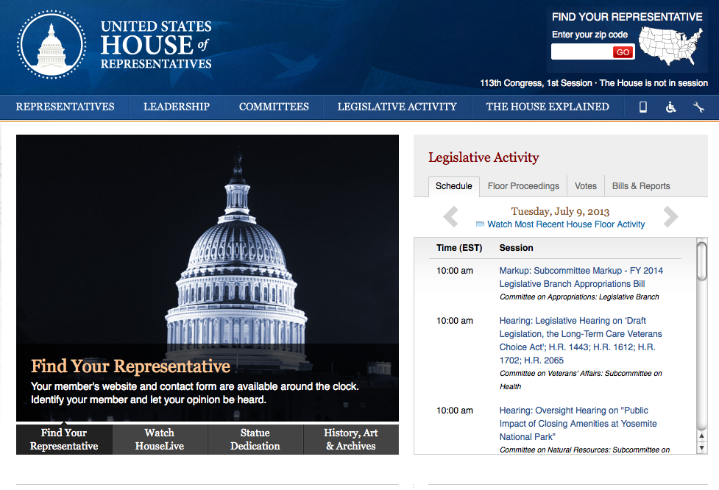
Your Representative house.gov

Slide 8
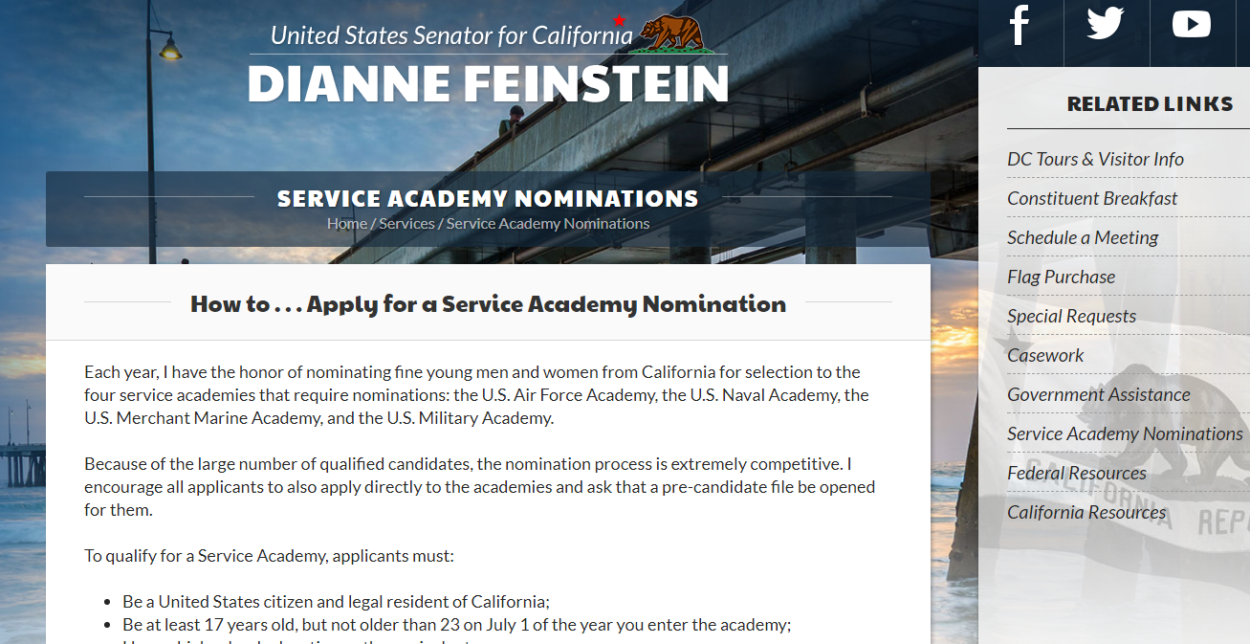
Senator Feinstein feinstein.senate.gov

Slide 9
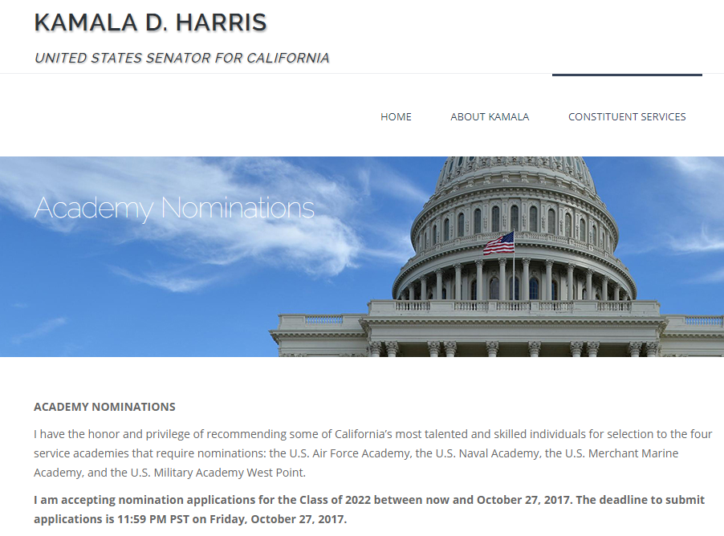
Senator Harris harris.senate.gov

Slide 10
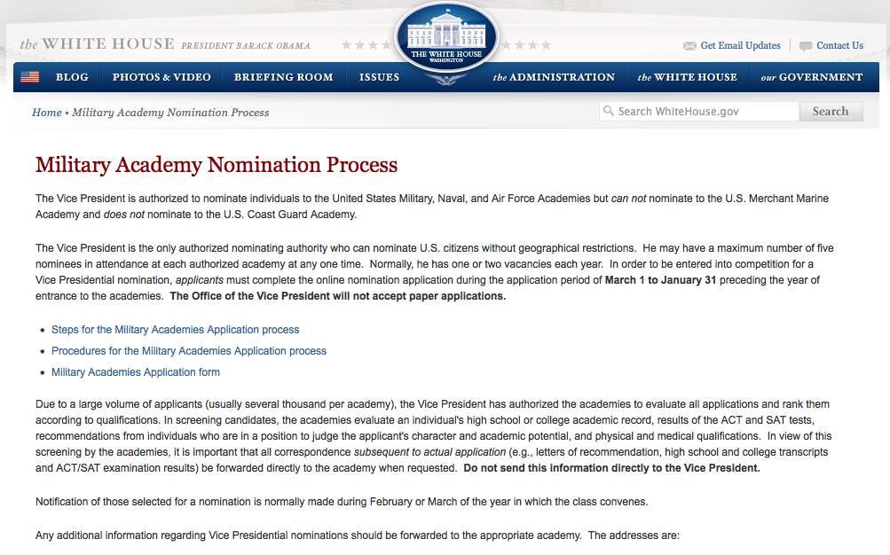
Vice President whitehouse.gov

Slide 11
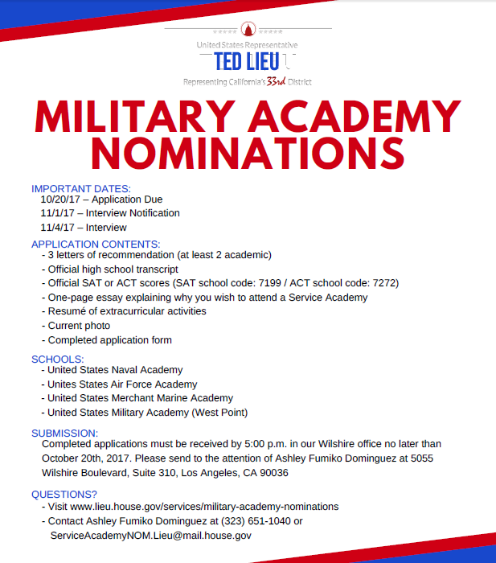

Slide 12




Questions?

