Slide 1
The ALO Interview
Telling Your Story
Colonel Steve Staso
USAFA ALO

Slide 2
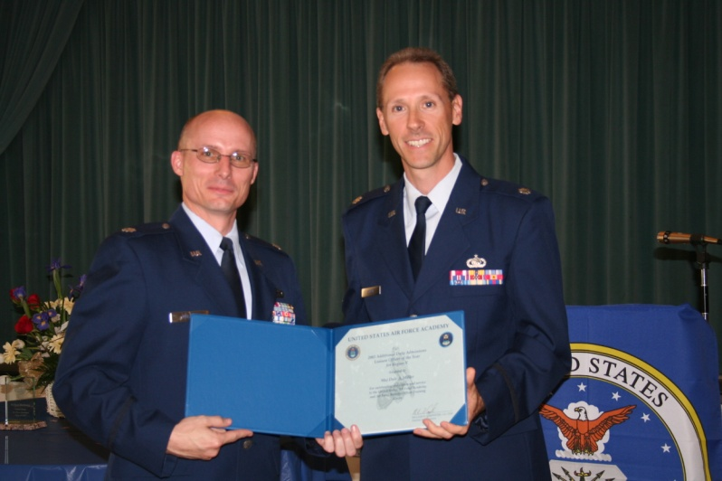
The Role of Liaison Officers
Mission
“Publicize Air Force Officer accessions programs and proactively identify, advise, and evaluate quality candidates who have the potential to succeed in the Air Force.”
...identify,
advise,
evaluate,
prepare…
2/7

Slide 3
What do ALOs do each year?
Identify and Mentor
  Contacted 55,984 students at school visits, college fairs, Academy nights, etc.
  4,717 separate high school marketing visits
  17,316 school contacts (phone, letter, email)
Evaluate
  Formal Interviews
    Total: 5,339: 4,592 USAFA and 747 AFROTC
Dedicate Resources
  Drove 575,406 miles
  Spent $184,187 out-of-pocket
Spent a total of 179,754 hours performing ALO duties
3/7

Slide 4

Admission Measures
Academic Composite
CFA
60%
Final
Selection
Composite
Weighted
Composite
+
Selection Panel
20%
Extracurricular
Composite
Medical
Category
20%
Liaison Officer and
Teacher Evaluations

Slide 5
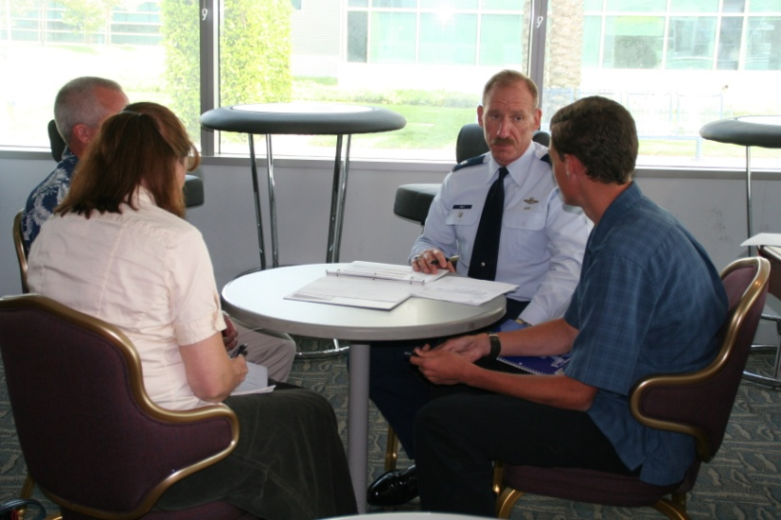
The Interview
It is a college AND a job interview – Dress Appropriately
It should not be the first time
you have met your ALO
Evaluation is in 3 Areas:
  Leadership & character
  Motivation to the Air Force
  Fitness
Focus is on your personal
characteristics and attributes
Help the ALO record your story – Have a Leadership Resume
  Don’t make the ALO have to play “20 questions”
  Be prepared to talk about yourself
  Know your strengths and your areas to improve
If you interview early, keep your ALO updated on your activities throughout the school year. He/She can update the evaluation and your rating.

Slide 6

The Interview
  Bring pen/paper
    Take notes on what to do next,
    improvement areas, etc.
  Check email/spam and vmail
    This is how USAFA and your ALO
    will communicate with you
  Leadership Resume
    Leadership positions, projects, situations, responsibilities
    Not a list of community service or extracurricular activities
    Situation or Task
    Actions
    Result
    How you made a positive impact
  Parents: Practice interviewing with role playing
STAR
IMPACT

Slide 7
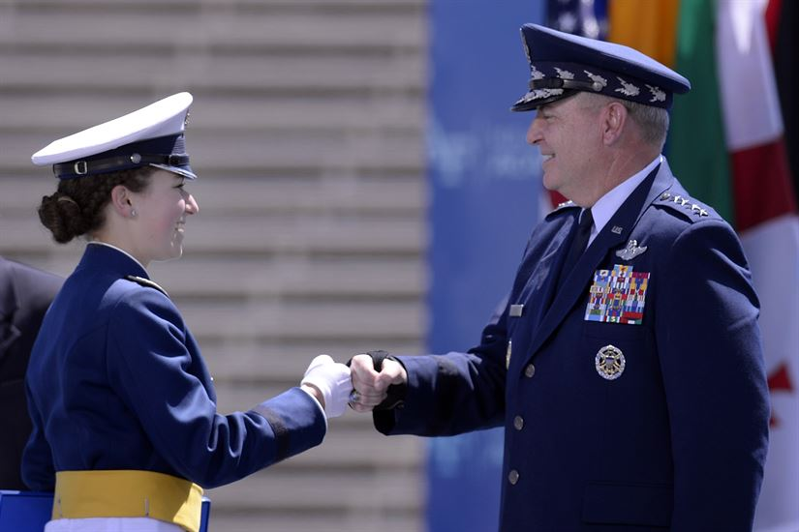
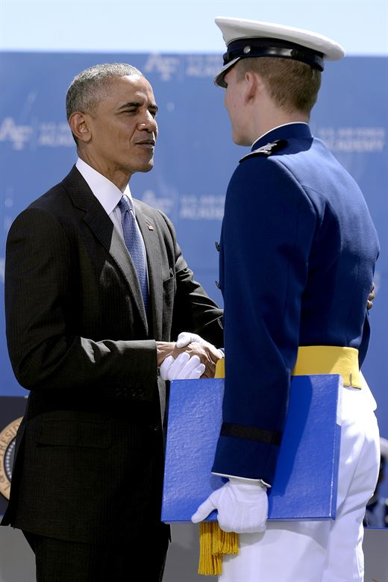
10 Ways to Maximize Your Chances for an Offer
Hope Is Not A Strategy!
Have Realistic Expectations & Plan B
Read The Candidate Instructions –
It’s All In There!
Start Now – Sense Of Urgency –
Be Proactive
Apply Early To ALL Nominating Sources
Keep Testing Until You Are Competitive
Practice The CFA Early – Time It
The Writing Sample Is An Opportunity…
Teacher Evaluations Are Important - Make A Plan
Communicate With Your ALO & Admissions Counselor
It’s a roller coaster ride – Stay flexible

Slide 8

Notes:
Attacking USAFA patch will determine end of brief.

